Slide 1
CSE322
The Chomsky Hierarchy
Lecture #16

Slide 2
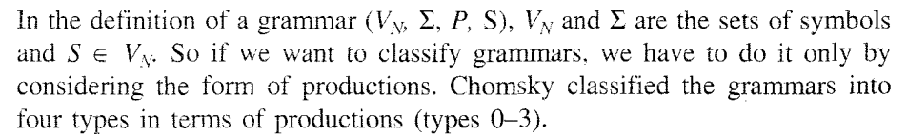
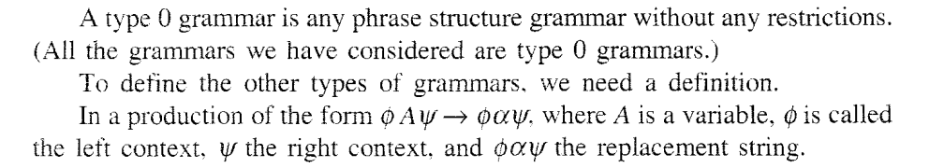

Slide 3
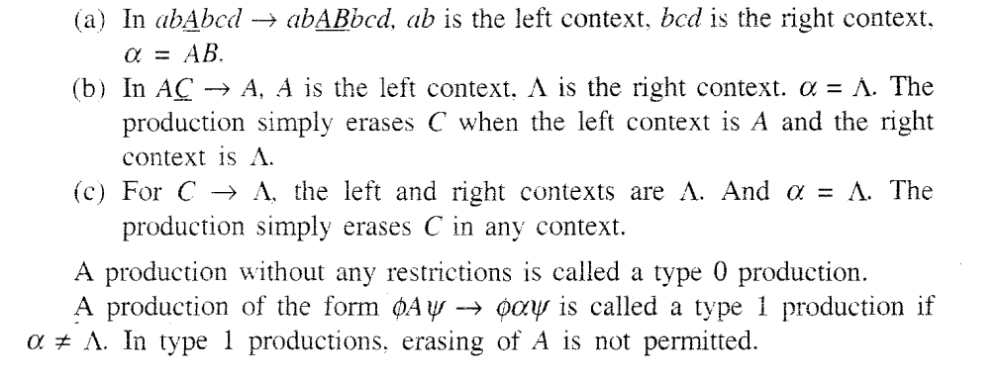

Slide 4
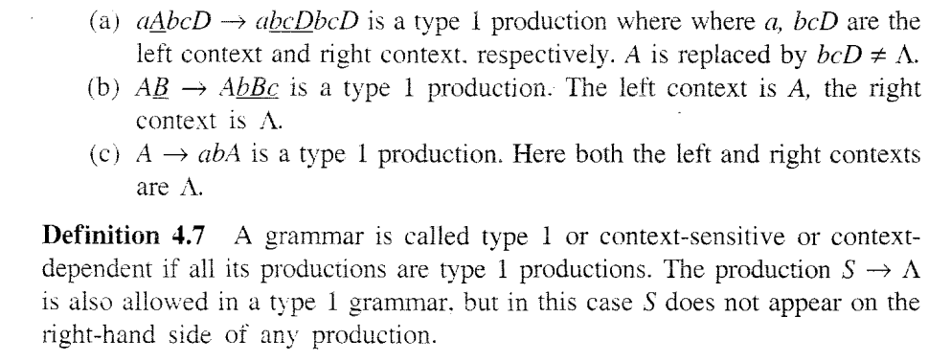
Type1

Slide 5
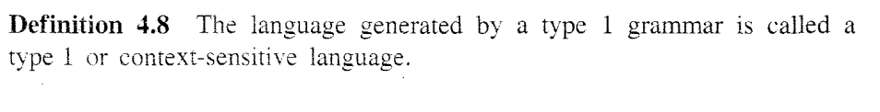
Type 1

Slide 6
Production Rule: aAb->agb belongs to which of the following category?
a) Regular Language
b) Context free Language
c) Context Sensitive Language
d) Recursively Ennumerable Language

Slide 7
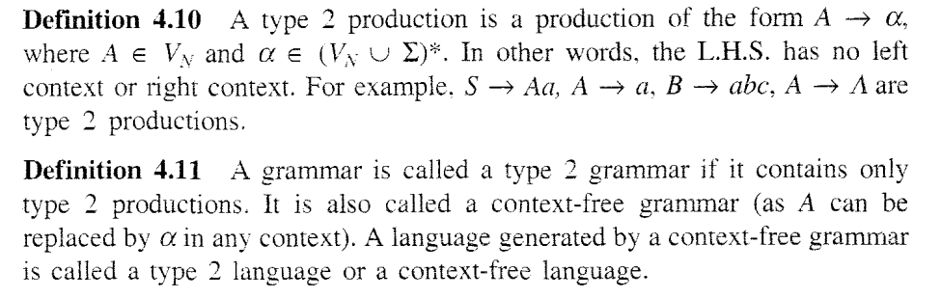
Type 2

Slide 8
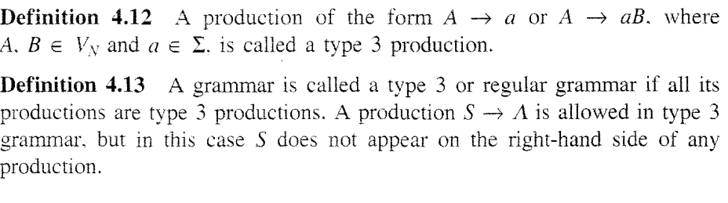
Type 3

Slide 9
. The entity which generate Language is termed as:
a) Automata
b) Tokens
c) Grammar
d) Data

Slide 10
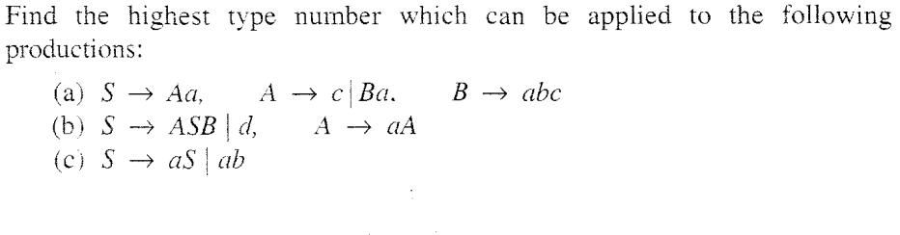
Questions

Slide 11
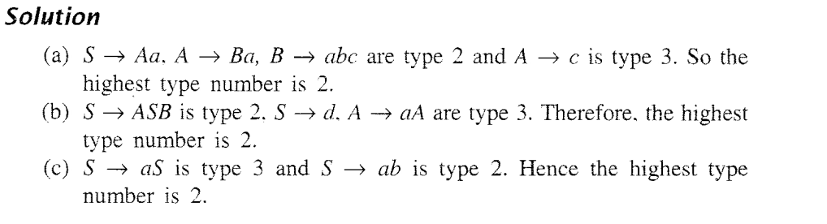
Solution

Slide 12
Let G be a grammar: S->AB|e, A->a, B->b
Is the given grammar in CNF?
a) Yes
b) No

Slide 13
With reference to the process of conversion of a context free grammar to CNF, the number of variables to be introduced for the terminals are:
S->ABa
A->aab
B->Ac
a) 3
b) 4
c) 2
d) 5

Slide 14
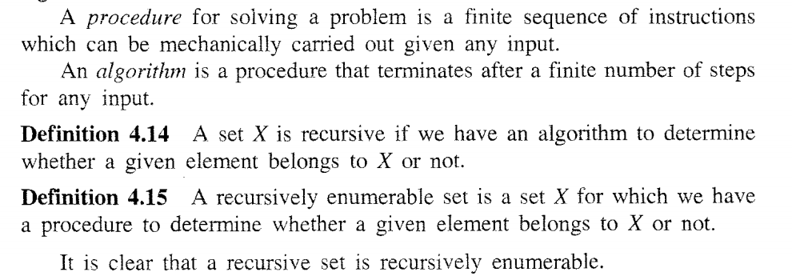
Recursive and Enumerable Sets

Slide 15
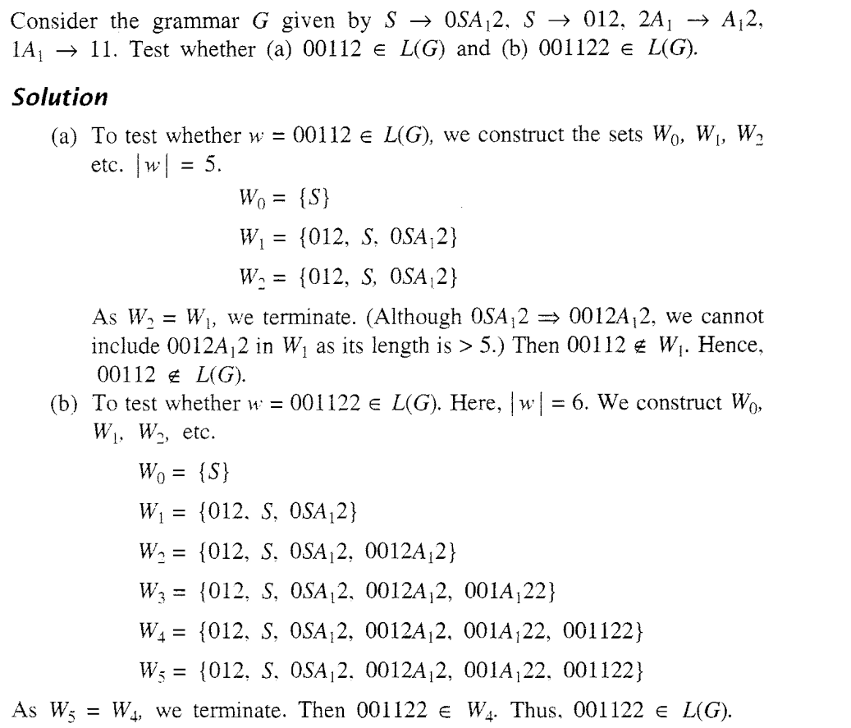

Slide 16
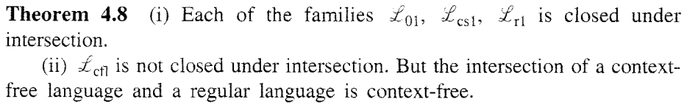

Slide 17
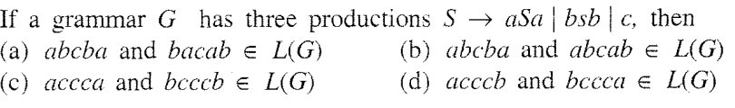

Slide 18
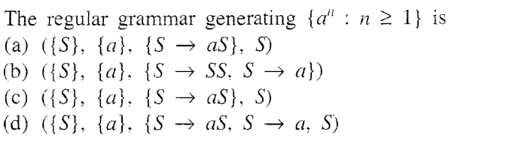

Slide 19
The Chomsky Hierarchy
Non Turing-Acceptable
Turing-Acceptable
decidable
Context-sensitive
Context-free
Regular

Slide 20
Which of the following statement is false?
a) Context free language is the subset of context sensitive language
b) Regular language is the subset of context sensitive language
c) Recursively ennumerable language is the super set of regular language
d) Context sensitive language is a subset of context free language

Slide 21
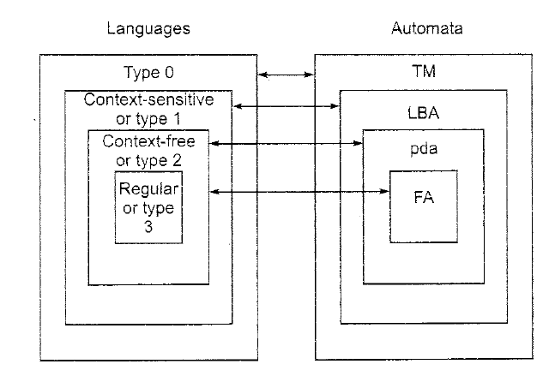
LANGUAGES AND AUTOMATON
Notes:
The Chomsky Hierarchy

Slide 22
Suppose a language L1 has 2 states and L2 has 2 states. After using the cross product construction method, we have a machine M that accepts L1 ∩ L2. The total number of states in M:
a) 6
b) 4
c) 2
d) 8

Slide 23
Which of the following statement is false?
a) Context free language is the subset of context sensitive language
b) Regular language is the subset of context sensitive language
c) Recursively ennumerable language is the super set of regular language
d) Context sensitive language is a subset of context free language

Slide 24
Which of the following statement is correct?
a) All Regular grammar are context free but not vice versa
b) All context free grammar are regular grammar but not vice versa
c) Regular grammar and context free grammar are the same entity
d) None of the mentioned

Slide 25
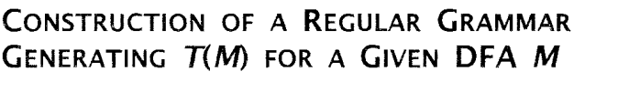
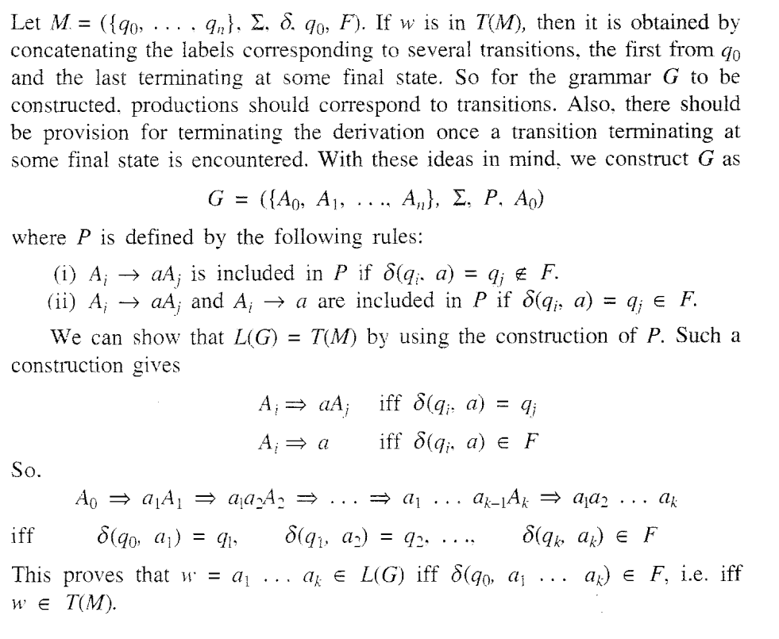

Slide 26
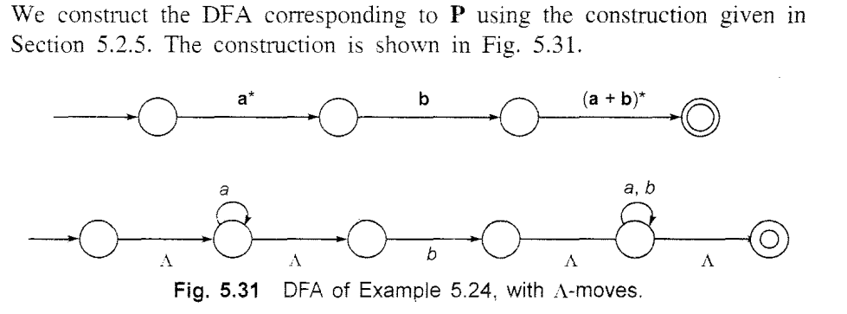

Slide 27
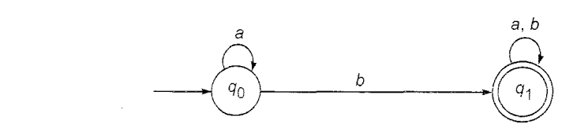
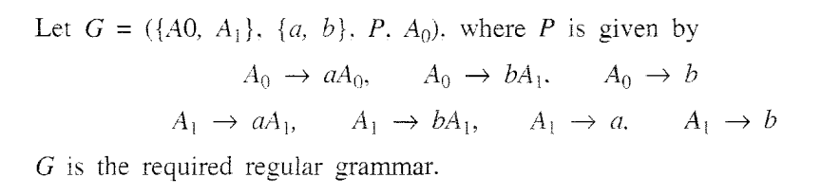

Slide 28
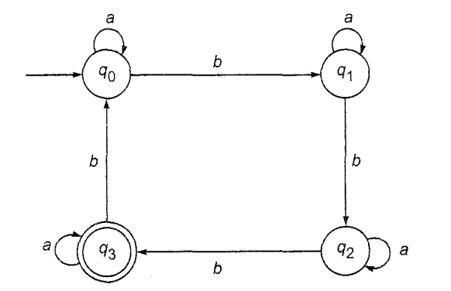
Construct a grammar for the given DFA

Slide 29
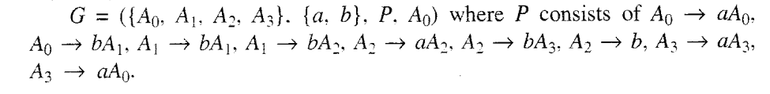

Slide 30
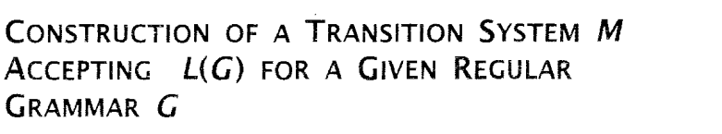
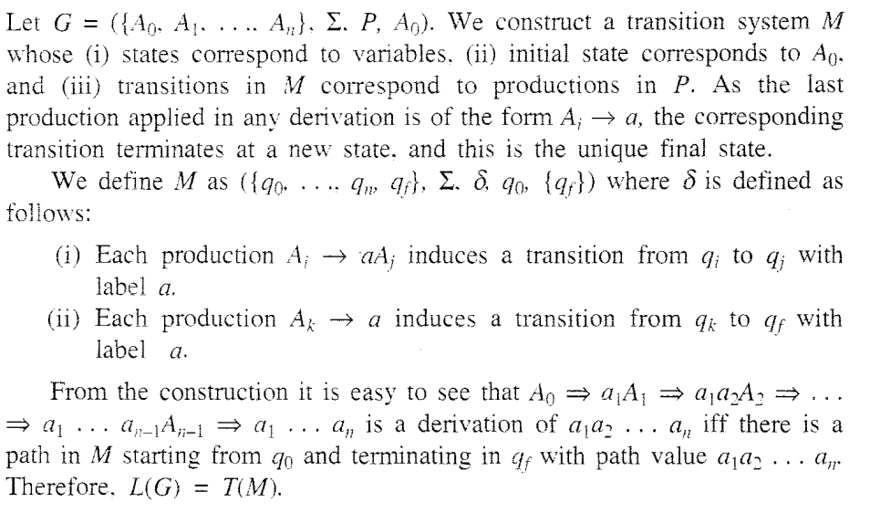

Slide 31
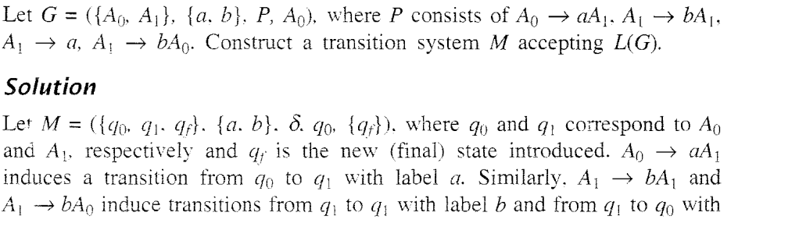

Slide 32
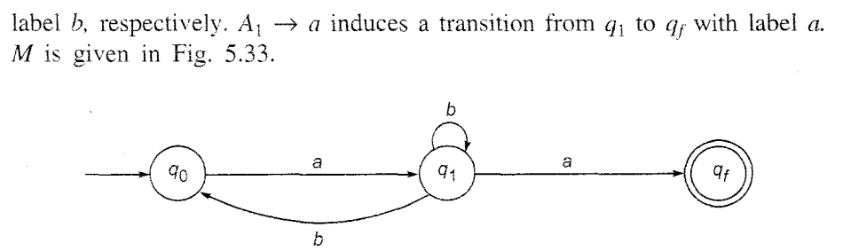

Slide 33
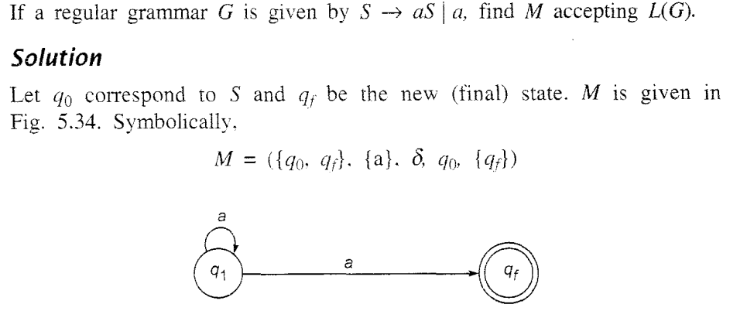


Slide 34
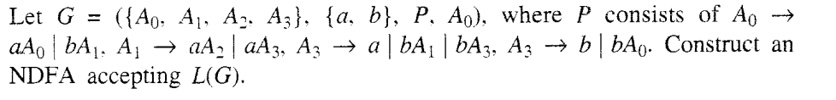

Slide 35
